Slide 1
Battle of the Neighborhoods
IBM Applied Data Science – Capstone Project

Slide 2
Problem statement
Where can we find Italian restaurant in New York city?
Which borough has more Italian restaurant?
Which are has less or no Italian restaurant?

Slide 3
Data
The project uses two database/dataset to accomplish its goal:
A New York dataset which can be downloaded from https://cocl.us/new_york_dataset link. The dataset contains borough of New York with their neighborhoods and Latitude and longitude. This will help use explore each neighborhood to locate Italian restaurant.
Foursquare API: This API has a database of more than 105 million places. This project would use Four-square API as its prime data gathering source. Many organizations are using to geo-tag their photos with detailed info about a destination, while also serving up contextually relevant locations for those who are searching for a place to eat, drink or explore. This API provides the ability to perform location search, location sharing and details about a business. Foursquare users can also use photos, tips and reviews in many productive ways to add value to the results.

Slide 4
Data continued…
Dependences
Pandas - Library for Data Analysis
NumPy – Library to handle data in a vectorized manner
JSON – Library to handle JSON files
Geopy – To retrieve Location Data
Requests – Library to handle http requests
Matplotlib and seaborn – Python Plotting Module
Sklearn – Python machine learning Library
Folium – Map rendering Library

Slide 5
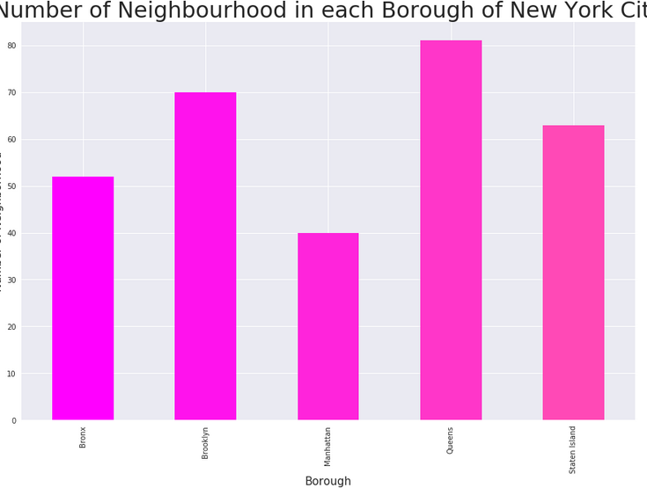
Results
A plot showing 5 borough of New York city with their number of neighborhoods.

Slide 6
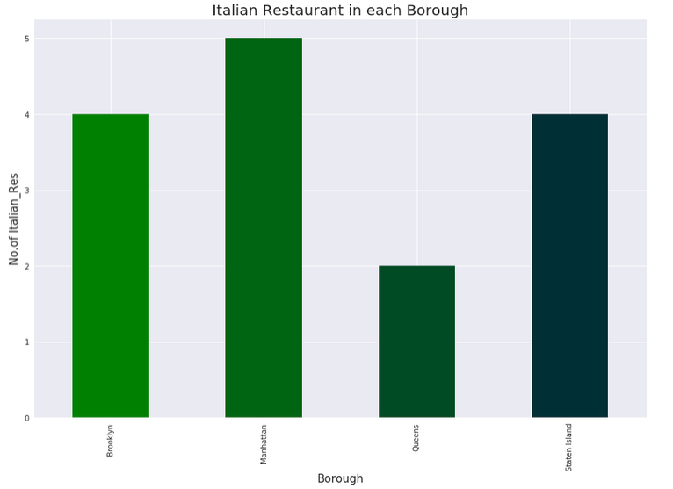
Results Continued…
A plot showing number of Italian restaurant in each borough of New York City.

Slide 7
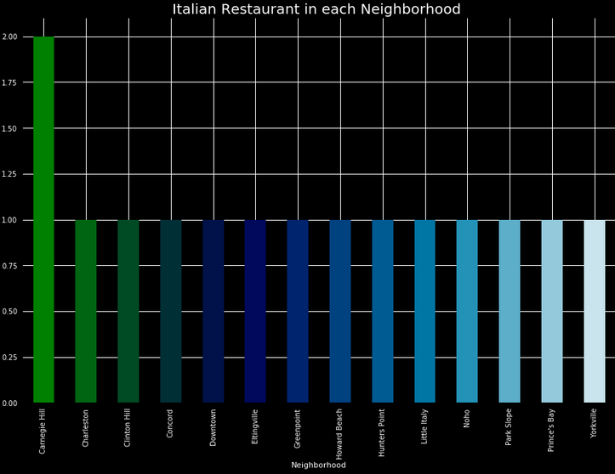
Results Continued..
A plot showing neighborhood with more Italian restaurant.

Slide 8
Discussion
From this experiment we have identify 5 Borough of New York City those are Queens, Bronx, Brooklyn, Manhattan, and Staten Island. We have also identified Queens having more neighborhoods than the rest boroughs of New York. With that being said we have found that Queens has less or few number of Italian restaurant. On the other hand Bronx have no Italian restaurant in its neighborhood. Manhattan has more Italian restaurant, while Brooklyn and Staten Island has equal number of Italian restaurant.
Recommended action:
1. For someone/ business that wants to open an Italian restaurant the best best places would be Queens since it more populated while the number of Italian restaurant are less or few compared to other regions and another one is Bronx since it has non Italian restaurants.
2. For a visiting individual the variate Italian restaurants are in Manhattan, Brooklyn, and Staten Island.

Slide 9
Conclusion
The experiment help us compare neighborhoods of New York with result and Facts.

